Slide 1
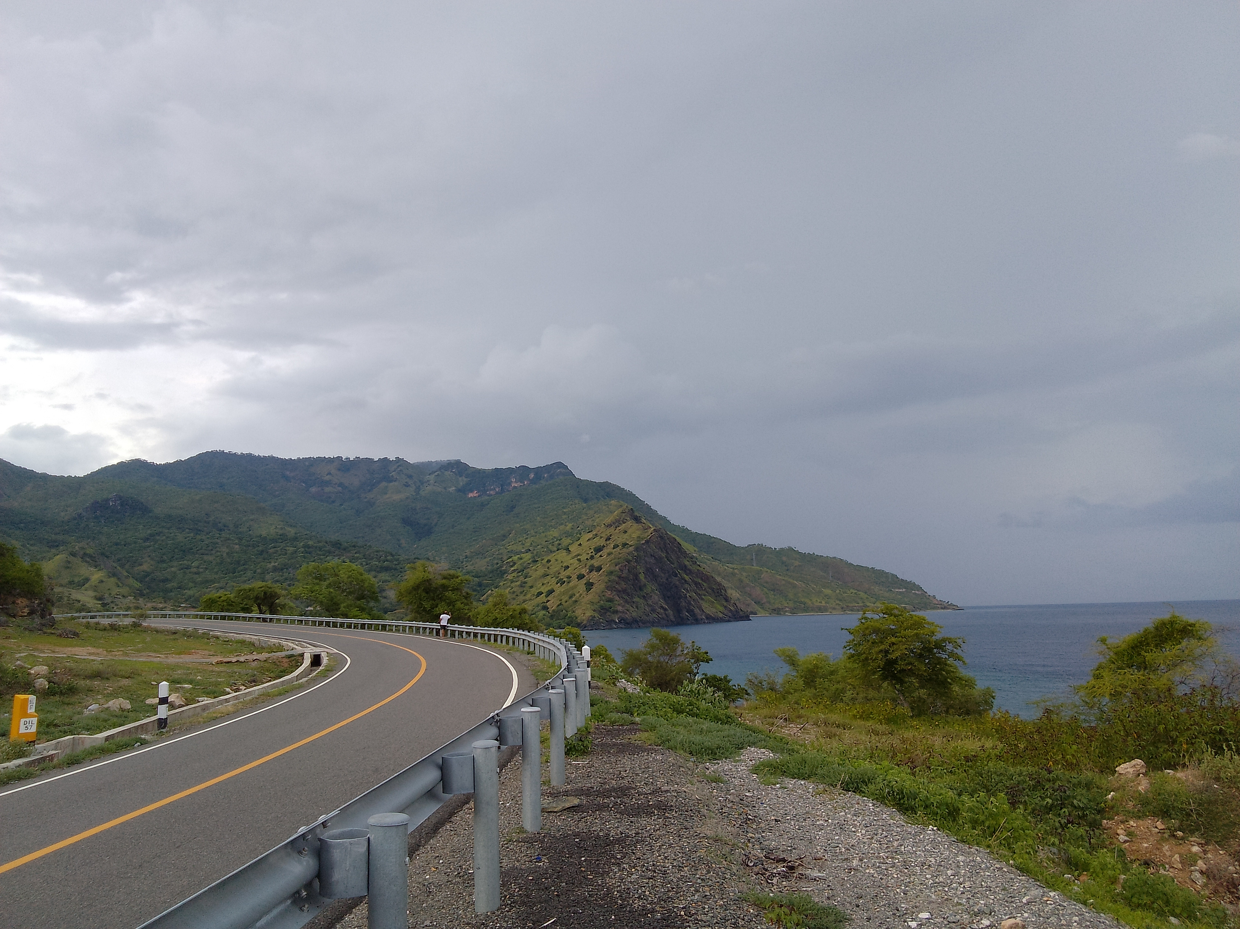


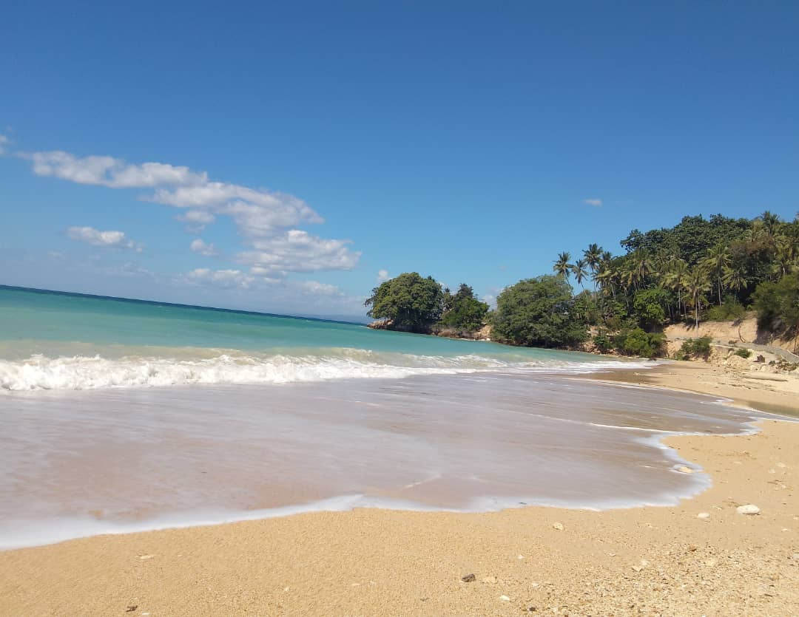
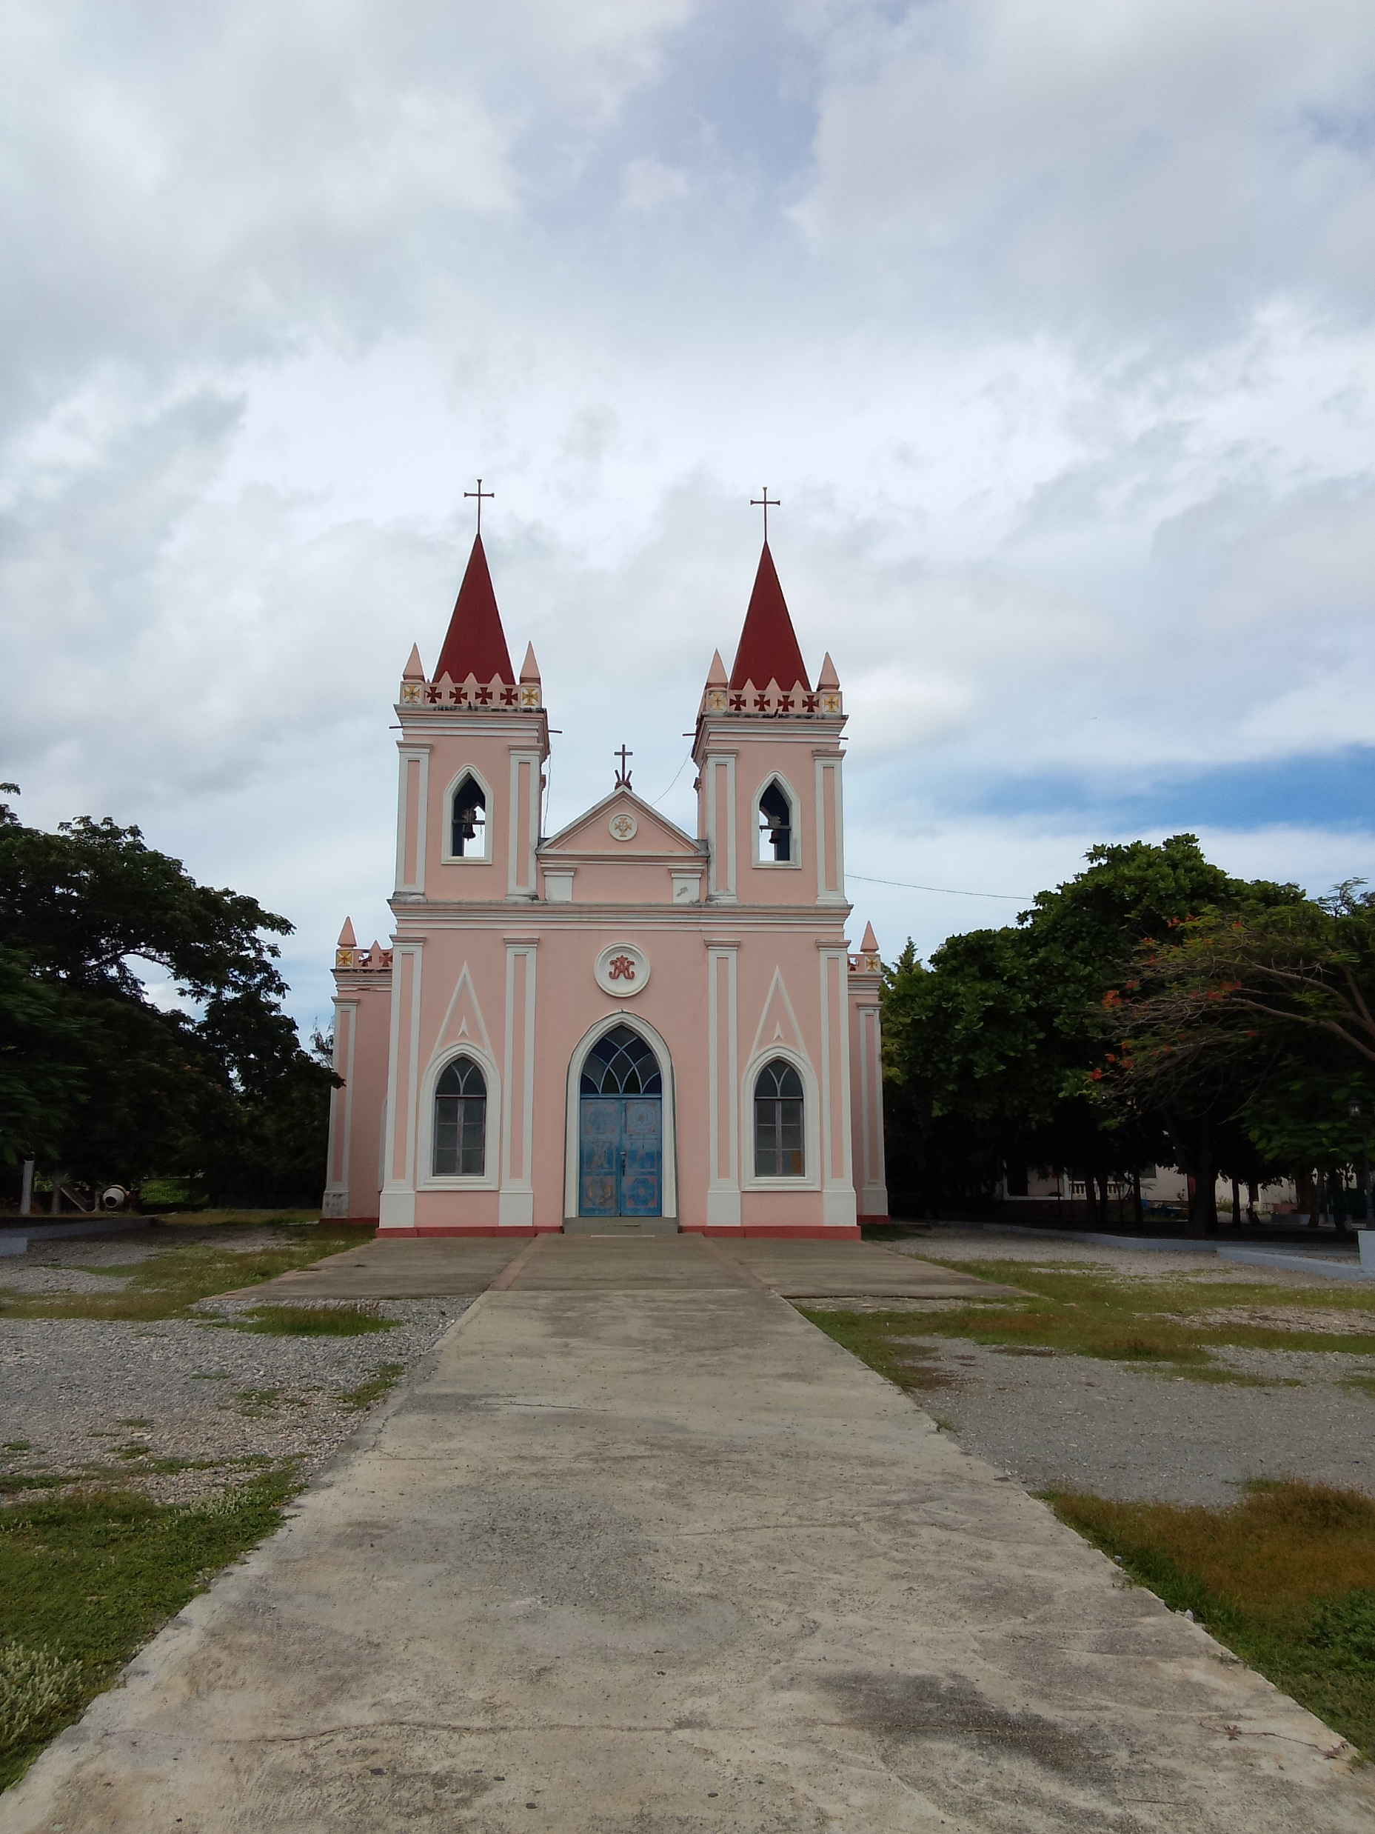
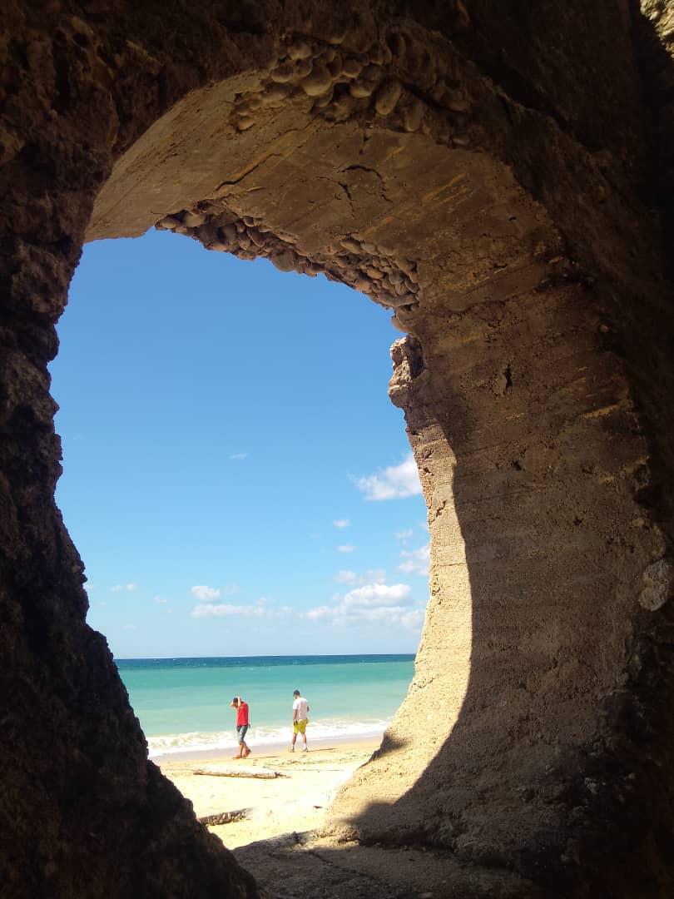
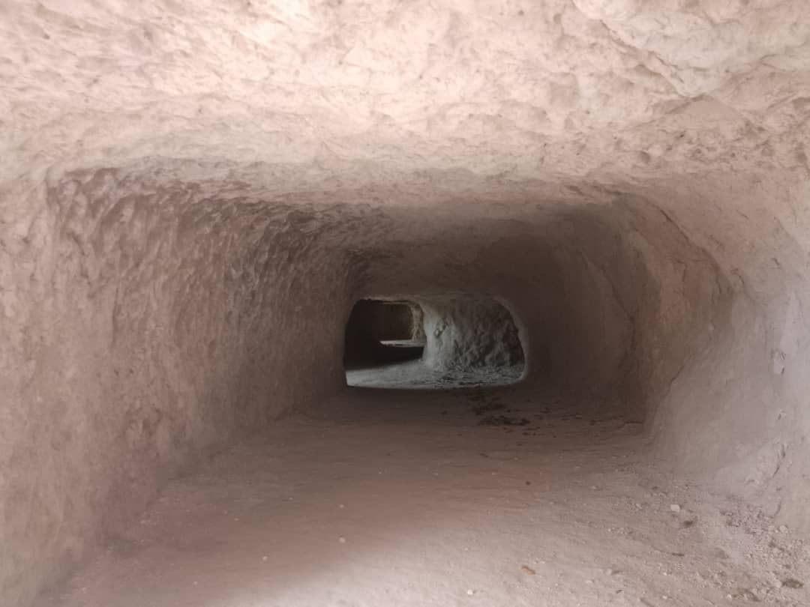


Tour Cost
$ 420 for 1 Person
$ 210 per person for 2
$ 150 per person for 3
2D/1N
Baucau N/E Overnight Tour
ABOUT OUR TOUR
Our 2D&1N Northeast Adventures and tour departs from Dili along the coastline to Baucau via Manatuto and Laleia the birth place of Xanana Gusmao. You will visit Mangrove park at Hera and the cemetery for the resistance at Metinaro. Whilst in Baucau, you will explore the second large city of Baucau, beaches and the Japanese 7 dug Caves during WWII itself.
D1. | Baucau Baucau Pousada | Dili – Baucau Travel East along the north coast Hera mangrove conservation and its monkey's spots Metinaro and the cemetery for the resistance Laleia, the birth place of Xanana Gusmao Lunch in the old town of Baucau Wataboo beach after lunch Visit Japanese 7 tunnels during WWII Visit the village of Venilale Return to Baucau and dinner at the Baucau Pousada
D2. | Dili NA | Return to Dili along the north east coast Swim in the Baucau pool Visit Watabou beach Explore the old and new town of Baucau Lunch at Amalia’s restaurant before heading back to Dili optional dinner at the hotel or seaside restaurant. End of our service.
Please note: the tour may vary slightly depending on the time of day, road conditions, etc. Please bring sunscreen, mosquito repellent, hat, refillable water bottle and USD cash in small denominations to purchase snacks and gifts.
ADDITIONAL EXPENSES
All meals & Accommodation at own cost
Personal items and spending
Tours Inclusion:
All transport and fuel during the tours
Your English-speaking driver/guide
Any entrance visit and drinking water during the trip
All Inquiries
+670 77345224 (Jonias)
timorindigenoustours@gmail.com

